Slide 1
The Health sector in India; Development and Challenges
Project by: Group-7
Arjun Borkhatariya – 1401015
Nisarg Tike – 1401070
Ravi Limbad – 1401077
Falgun Prajapati – 1401080
Kedar Acharya – 1401081
Anuj Shah – 1401084
Shloak Agarwal – 1401105
Arjun Sanchala - 131004

Slide 2
Advantage of India in medical sector
Strong demand
Attractive Opportunities
Quality and Affordability

Slide 3
Strong demand
Healthcare revenue in India is set to reach USD280 billion by 2020.
Expenditure is likely to expand at a CAGR (Compound annual growth rate) of 17 per cent over 2011–20.
Rising incomes, greater health awareness, lifestyle diseases and increasing access to insurance will contribute to growth.

Slide 4
Attractive Opportunities
Investment in healthcare infrastructure is set to rise, benefiting both ‘hard’ (hospitals) and ‘soft’ (R&D, education) infrastructure.
India is the largest exporter of formulations with 14 per cent market share and ranks 12 in the world in terms of export value.
Double-digit growth is expected over the next five years.

Slide 5
Quality and affordability
Availability of a large pool of well-trained medical professionals in the country
India has an advantage over its peers in the West and Asia in terms of cost of high-quality medical services offered.

Slide 6
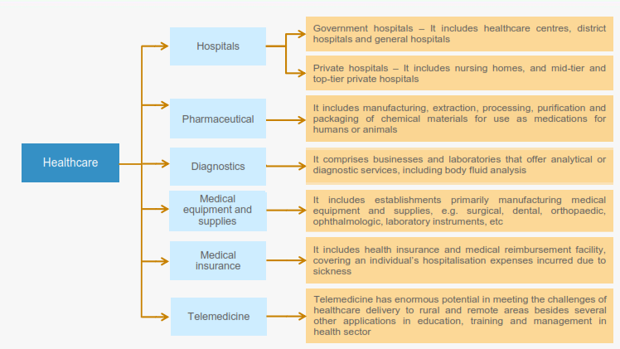
Functioning of health-care in India

Slide 7
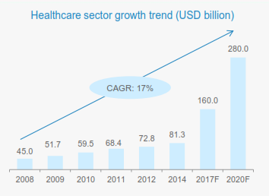
Strong growth in Healthcare expenditure

Slide 8
Strong growth in Healthcare expenditure
Healthcare has become one of India's largest sectors both in terms of revenue and employment. The industry is growing at a tremendous pace owing to its strengthening coverage, services and increasing expenditure by public as well private players.
During 2008-20, the market is expected to record a CAGR of 17 per cent.
The total industry size is expected to touch USD160 billion by 2017 and USD280 billion by 2020.
As per the Ministry of Health, development of 50 technologies has been targeted in the FY16, for the treatment of disease like Cancer and TB.
Government is emphasising on the eHealth initiatives such as Mother and Child Tracking System (MCTS) and Facilitation Centre (MCTFC).

Slide 9
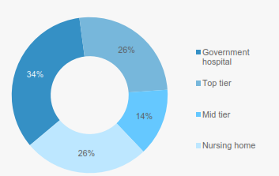
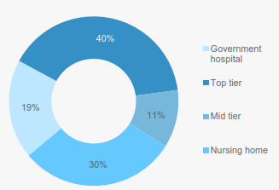
Shares in healthcare spending in India 2005 and 2015

Slide 10
Inferences
PRIVATE SECTOR HAS A STRONG PRESENCE IN INDIA’S HEALTHCARE SECTOR.
The private sector has emerged as a vibrant force in India’s healthcare industry, lending it both national and international repute.
Large investments by private sector players are likely to contribute significantly to the development of India’s hospital industry, which comprises around 80 per cent of the total market.
In India, private healthcare accounts for almost 74 per cent of the country’s total healthcare expenditure.
Private sector’s share in hospitals and hospital beds is estimated at 74 per cent and 40 per cent, respectively.
The main factor contributing to rising medical tourism in India is presence of a well-educated, English-speaking medical staff in state-of-the art private hospitals and diagnostic facilities.

Slide 11
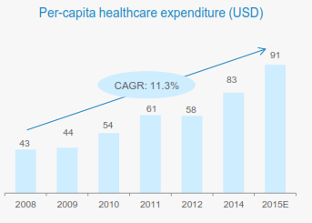
Per capita healthcare expenditure has risen at a fast pace

Slide 12
Inferences
Per capita healthcare expenditure is estimated at a CAGR of 11.3 per cent during 2008–15E to USD91 Billion by 2015.
This is due to rising incomes, easier access to high-quality healthcare facilities and greater awareness of personal health and hygiene.
Greater penetration of health insurance aided the rise in healthcare spending, a trend likely to intensify in the coming decade.
Economic prosperity is driving the improvement in affordability for generic drugs in the market.

Slide 13
KEY PLAYERS IN THE MARKET – HOSPITALS AND NO OF BEDS
Apollo Hospitals Enterprise – 9215
Aravind Eye Hospitals – 3649
CARE Hospitals - 2,100
Fortis Healthcare Ltd - 10,000
Max Hospitals - 1,973
Manipal Group of Hospitals - 4900
Narayana Health - 6,498

Slide 14
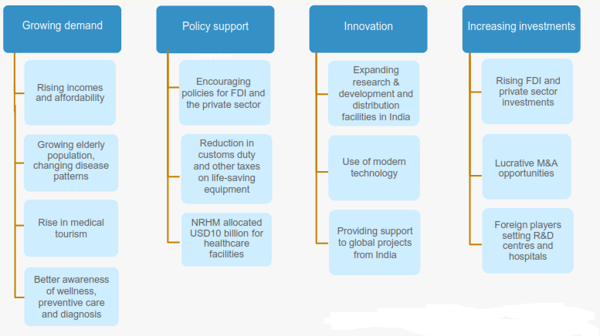
Indian Health Sector is poised to grow. How?

Slide 15
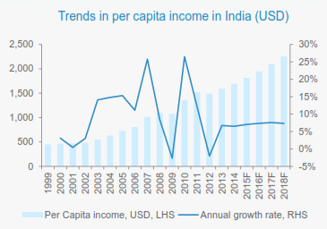
Key reasons for healthcare demand

Slide 16
Key reasons for healthcare demand
Rising incomes mean a steady growth in the ability to access healthcare and related services.
Per capita income is expected to increase at a CAGR of 7.33 per cent over 2014–18.
Per capita expenditure on healthcare in India was estimated by 2015 was USD88.7.
Moreover, changing demographics will also contribute to greater healthcare spending; this is likely to continue with the size of the elderly population set to rise from the current 98.9 million to about 168 million by 2026.

Slide 17
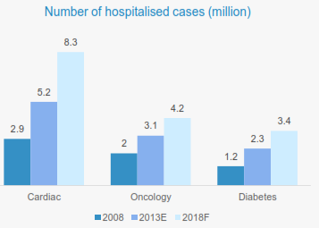
Lifestyle diseases and growing awareness to increase hospitalisation

Slide 18
Lifestyle diseases and growing awareness to increase hospitalisation
The purported rise of lifestyle diseases in India is expected to boost industry sales figures.
Increased incidences such as heart disease, obesity and diabetes have contributed to rising healthcare spending by individuals.
Growing health awareness and precautionary treatments coupled with improved diagnostics are resulting in an increase in hospitalisation.
Indian system of healthcare, Ayurveda has unique therapies which are beneficial for treatment of many chronic lifestyle disorders and thus attracting more number of patients to avail these services in India.
CAGR of hospitalised cases from 2008 – 18:
Cardiac – 18 per cent
Oncology – 16 per cent
Diabetes – 19 per cent

Slide 19
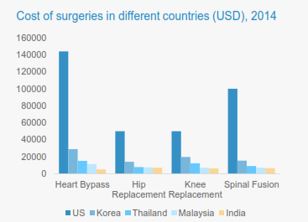
Medical tourism: a new growth factor for India's healthcare sector

Slide 20
Medical tourism: a new growth factor for India’s healthcare sector
Presence of world-class hospitals and skilled medical professionals has strengthened India’s position as a preferred destination for medical tourism.
Superior quality healthcare, coupled with low treatment costs in comparison to other countries, is benefiting Indian medical tourism which has, in turn, enhanced the prospects of the Indian healthcare market.
Treatment for major surgeries in India costs approximately 20 per cent of that in developed countries.
India also attracts medical tourists from developing nations due to lack of advanced medical facilities in many of these countries.
Medical tourism market is expected to expand at a CAGR of 16.42 per cent to reach USD1.79 billion in 2015 from USD980 million in 2011.
Inflow of medical tourists is expected to cross 3.2 million by 2015 compared to 0.85 million in 2012.
Yoga, meditation, ayurveda, allopathy and other traditional methods of treatment are major service offerings that attract medical tourists from European nations and the Middle East to India.

Slide 21
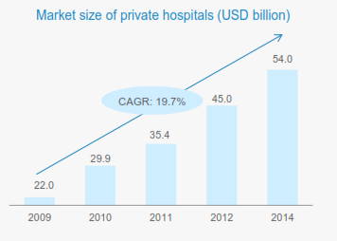
Private players are key contributors to growth in number of hospitals

Slide 22
Private players are key contributors to growth in number of hospitals
A major portion of secondary, tertiary and quaternary healthcare institutions comes from private sector with a concentration in metros, tier II and tier I cities.
Large investments by private sector players are likely to contribute significantly to the development of India's hospital industry and the sector is poised to grow to USD100 billion by 2015 and further to USD280 billion by 2020.
The private hospital market in India is estimated at USD54.0 billion at end-of 2014.
Over 2009–14, the market size of private hospitals is estimated to have CAGR of 19.7 per cent.
Increase in number of hospitals in Tier-II and Tier-III cities has fuelled the growth of private sector.

Slide 23
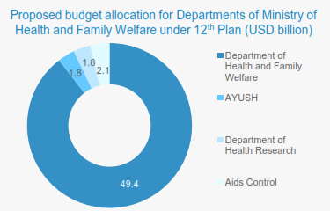
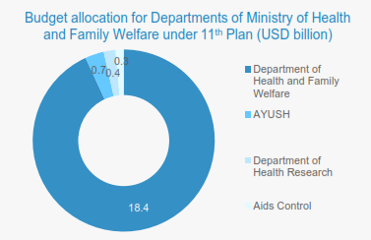
Healthcare is a key focus area under the 12th five-year plan (2012–17)

Slide 24
Summary - Buzzword
Cost Advantage.
Favourable investment environment.

Slide 25
Cost Advantage
The low cost of medical services has resulted in a rise in the country’s medical tourism, attracting patients from across the world.
Moreover, India has emerged as a hub for R&D activities for international players due to its relatively low cost of clinical research.

Slide 26
Favourable investment environment
Conducive policies for encouraging FDI, tax benefits, favorable government policies coupled with promising growth prospects have helped the industry attract private equity, venture capitals and foreign players.

Slide 27
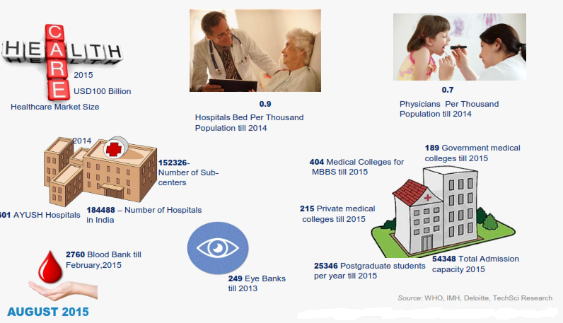
Statistics of health-care in India

Slide 28
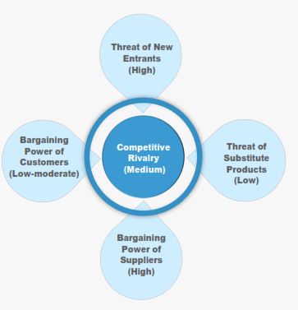
Five Force Analysis

Slide 29
Competitive rivalry
Increase in number of private players in the market has led to increased competition.
However number of hospitals is still low compared to the requirement so there is not much competition in the market.

Slide 30
Substitute Products
Customers may go for public hospitals which are inexpensive.
Customers might go for E-Health.

Slide 31
Bargaining Power of Suppliers
Bargaining power of suppliers in this industry is high because quality of products and timely delivery matter and there are less number of quality suppliers.

Slide 32
Bargaining Power of Customers
Bargaining power of customers is low because of trust and loyalty however increase in number of options has given customers some bargaining power.

Slide 33
Major Challenges
Health indicators continue to lag
Low healthcare spend
Rural Versus Urban Divide
Infrastructure gaps and under-utilization of resources
Need for better framework
Lack of public-private collaboration

Slide 34
Health indicators continue to lag
Outcome indicators such as IMR(Infant mortality rate) and life expectancy continue to fall behind LMIC averages.
According to WHO, the non-communicable disease burden has grown to 53% of the total disease burden by 2008.

Slide 35
Low healthcare spend
India’s healthcare spending as a percentage of GDP has reduced from 4.4% in 2000 to 4% in 2010.
This implies that India’s healthcare expenditure has grown at a slower rate than its GDP.

Slide 36
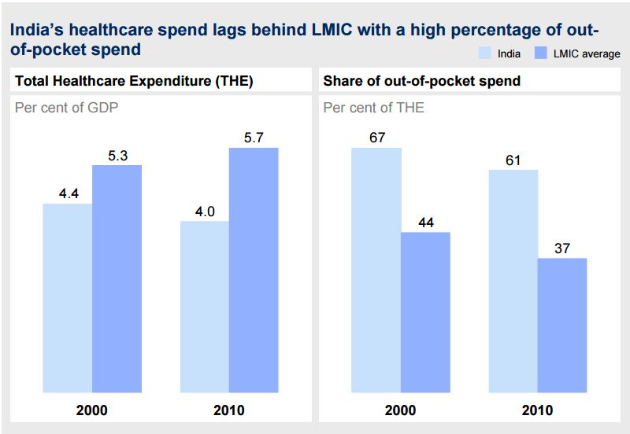

Slide 37
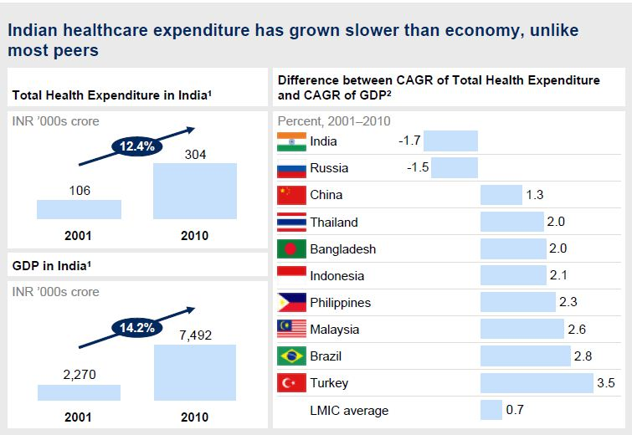

Slide 38
Rural Versus Urban Divide
There are wide gaps between the rural and urban populations in healthcare system.
According to the World Bank and National Commission’s report on Macroeconomics, only 5% of Indians are covered by health insurance policies.
Inaccessibility to healthcare services in rural areas is a common problem. Other factors include physical reach, capacity, quality and affordability.

Slide 39
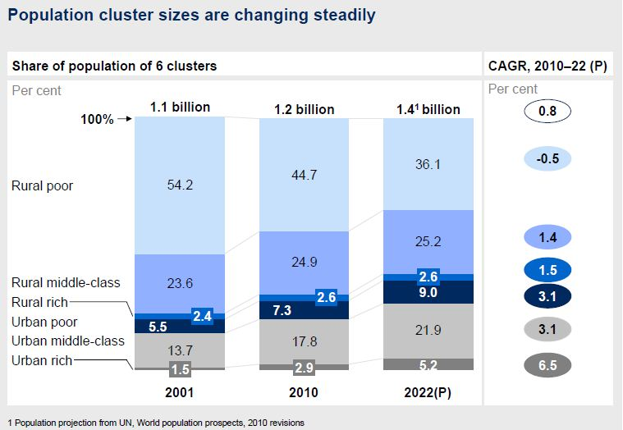

Slide 40
Infrastructure gaps and under-utilization of resources
Bed density in the year 2002 was 0.67 compared to global average of 2.6.
Total bed density had increased to 1.3 per 1000 by 2010 but remained significantly lower than the WHO recommendation of 3.5 beds per 1000.
Private sector hospitals routinely face utilization issues.
Utilization of public sector facilities remains low.

Slide 41
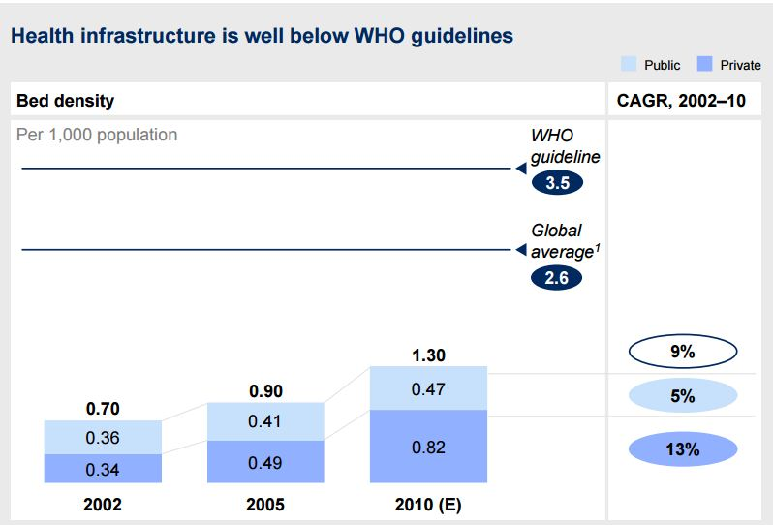

Slide 42
Inadequate health workforce
India had 1.7 trained doctors and nurses per 1000 population in the year 2000 compared to the WHO recommended guideline of 2.5 per 1000 population.

Slide 43
Need for better framework
A well-functioning and effective system is required to manage the large and diverse set of services providers in India.
New legislations like ‘The Clinical Establishments Registration Act’ have been passed but the implementation has lagged.

Slide 44
Lack of public-private collaboration
There has been significant lack of public-private partnership.
While government sponsored social insurance programs have grown rapidly, nearly 75% of the population remains uncovered.

Slide 45
Conclusion
There are vast opportunities for investment in healthcare infrastructure in both urban and rural India .
Rural India, which accounts for over 70 per cent of population is set to emerge as a potential demand source.
Overall, there are threats and challenges but these can be overcome by proper policy-frame-work, increased awareness and effective implementation.

Slide 46
References
http://www.searo.who.int/india/areas/country_cooperation_strategy/WHOIndia_CCS_2012-2017_2._India's_Health_and_Development_Challenges_and_Responses.pdf
http://thefivefortyfive.com/the-healthcare-conundrum-indias-5-big-challenges
http://usf.vc/investor-info/india-healthcare-challenges-and-opportunities/
India Healthcare: Inspiring possibilities, Challenging journey-Confederation of Indian Industry (CII)

